Slide 1
Tone Words B

Slide 2
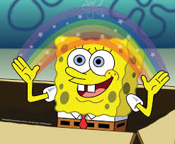
whimsical
playfully quaint or fanciful, especially in an appealing and amusing way

Slide 3
malicious
Intended to hurt or harm

Slide 4
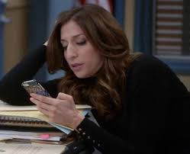
disinterested
having or feeling no interest in something; not influenced by considerations of personal advantage

Slide 5
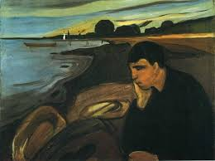
melancholy
a feeling of deep sadness

Slide 6
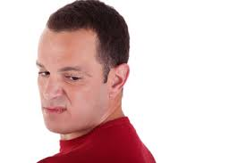
disdainful
showing contempt or lack of respect

Slide 7
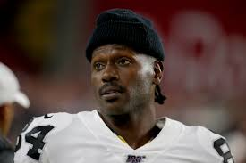
brash
self-assertive in a rude, noisy, or overbearing way

Slide 8
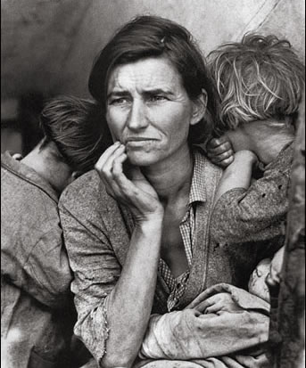
poignant
deeply affecting or moving to the emotions

Slide 9
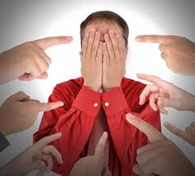
accusing
directing blame or responsibility toward someone or something

Slide 10
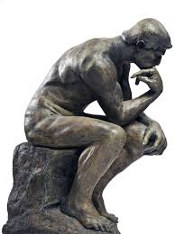
contemplative
expressing or involving prolonged thought, meditation or reflection

Slide 11
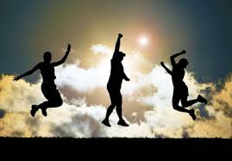
exuberant
filled with or characterized by a lively energy and excitement

Slide 12
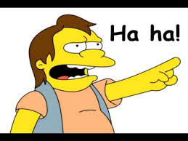
mocking
making fun of someone or something in a cruel way

Slide 13
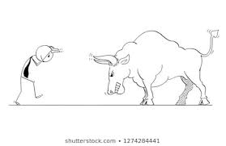
provocative
causing annoyance, anger, or another strong reaction, especially deliberately

Slide 14
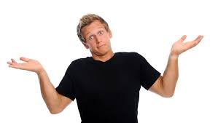
Resigned
having accepted something unpleasant that one cannot do anything about.

Slide 15
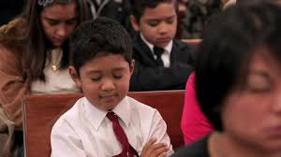
Reverent
feeling or showing deep and solemn respect.

