Slide 1
Week 2 PPT Monday: *Pick-up your IR book from the shelf; Make sure it is yours (check post-it)
Unit Test: January 24^{th SGM: Thursday}

Slide 2
Independent Reading
Expectations:
Have a book.
Read actively.
Stay Awake.
Keep your cellphone put away.

Slide 3
Reminder: 1st “Big” assignment Due
Flipgrid Assignment Part 1: Due Monday, January 13th by 11:59PM;
Part 2: Due Wednesday, January 15th by 11:59PM

Slide 4
Agenda
Warm-up:
9 Alignments
Two Kinds
Questions, Chunk 7&8, Quiz Feedback
Review CEIEI
Write CEIEI Two Kinds
OPTIC
Frida Kahlo

Slide 5
9 Alignments
Analyzing Characters in a story
(Using/ applying characterization)

Slide 6
Article: What is an alignment?
9 alignment descriptors
Popular TV and Movie alignments

Slide 7
Lawful Good Follows a code, either internal or external (told what to do) Helps people (good soldier, or Superman type) | Neutral Good Sometimes follows a code, sometimes willing to break or bend rules for own benefit Helps People | Chaotic Good A Rebel Follows no rules or code Does what they want Helps people
Lawful Neutral Follows a code, either internal or external Focused solely on rules or code Does nothing to help or hurt. | True Neutral Has no discernible alignment either way. Does nothing good or evil, shows no law or chaos Wild animals fall into this category | Chaotic Neutral Does what they wish for their own personal gain Does nothing to help or hurt.
Lawful Evil Follows a code, either internal or external (told what to do) Hurts people (evil soldier) | Neutral Evil Has a reason for what he or she does Hurts people (NORMALLY the main villain) | Chaotic Evil Does whatever they want Hurts people Has no real reason for what they do

Slide 8
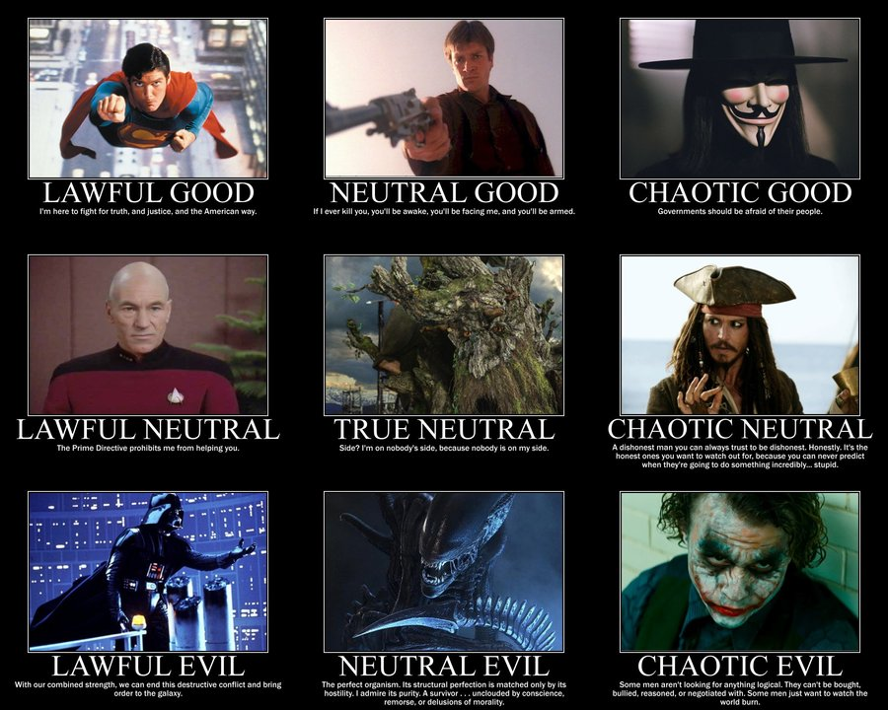

Slide 9
Tuesday: *Pick-up your IR & the Close Reading Article from the front of the room
*Quiz Today
*Unit Test: January 24th

Slide 10
Once you complete the quiz, turn it in on the front table and take time to read your novel.
Goal: 10 minutes uninterrupted reading
Independent Reading
Expectations:
Have a book.
Read actively.
Stay Awake.
Keep your cellphone put away.

Slide 11
Reminder: 1st “Big” assignment Due
Flipgrid Assignment Part 1: Due Monday, January 13th by 11:59PM;
Part 2: Due Wednesday, January 15th by 11:59PM

Slide 12
Agenda I can write a paragraph with a formal claim and evidence using a lead-in.
Warm-up: Cold Reading #3
Two Kinds CEIEI
Two Kinds Quiz

Slide 13
Writing a Claim Statement
What is a claim?
ONE sentence
States an opinion (arguable)
Contains a reason (why?)
IT does not contain any 1st or 2nd person pronouns (I, you, we, etc.).
I know it’s what you think. You’re the one writing it. IF you turn in papers that start with “I think” I’m going to set them on fire.
Example:
Hillgrove High School consistently proves to be the most desired school to attend in Cobb County because of its academic reputation.
Go through the checklist. Is the claim complete?

Slide 14
Claim and evidence
Most common/ ultra basic lead-in = According to (author’s name), “direct quote” (citation).
You cannot just plop a quote into a paragraph. You need a lead-in

Slide 15
Today you are typing your first CEIEI paragraph for Two Kinds
Use this link to type and submit your paragraph:
https://tinyurl.com/twokindssp20
Remember, this is a way for us to get an idea of where you are with your writing.

Slide 16
Wednesday: *Pick-up your IR & Writer’s Notebook
*Unit Test: January 24th ~ *SGM: tomorrow

Slide 17
Agenda I can write a paragraph with a formal claim and evidence using a lead-in.
Warm-up: 10 minutes
Writer’s Notebook #2 - 1/15
Group 1: Two Kinds CEIEI
Feedback
Group 2: By Any Other Name Pt.2
Annotate
Group 3: Frida Kahlo
OPTIC

Slide 18
Writer’s Notebook #2 Today’s date 1/15/2020; Start page 5
Be sure to fill out the Table of Contents
Be sure to title and date page 5
Prompt:
Think about a time when you struggled with your identity. Perhaps your conflict was because you did not feel like you fit in with a certain group of people. Your conflict may have been a struggle like the character in Ethnic Hash or an actual conflict like the struggle between Jing Mei and her mother.
Goal: Develop your ideas in a journal of at least 3/4 of a page.

Slide 19
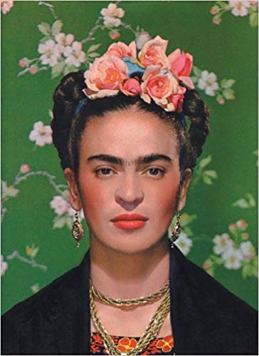
What is magic realism?
A literary or artistic genre in which realistic narrative and naturalistic technique are combined with surreal elements of dream or fantasy
Created to spite the rise of avant-garde art after WW1.
Who is Frida Kahlo?
A female artist who lived in Mexico City during the 1940’s, painted many pieces that were considered political and abstract for her time.
“I don’t paint dreams or nightmares, I paint my own reality.” –Frida Kahlo

Slide 21
Thursday: *Pick-up your IR
*Unit Test: January 24th

Slide 22
Agenda I can write a paragraph with a formal claim, evidence using a lead-in, and use a transition.
SGM
Do your best; Bring IR.
By Any Other Name; CEIEI feedback; Frida Kahlo OPTIC
“Two Kinds” Quiz
feedback
HW: Prep for 2nd CEIEI
How does identity cause conflict in the short story?
Last Group Rotation

Slide 23
Friday: *Pick-up your IR
*Unit Test: January 24th

Slide 24
Once you complete the quiz, turn it in on the front table and take time to read your novel.
Goal: 10 minutes uninterrupted reading
Independent Reading
Expectations:
Have a book.
Read actively.
Stay Awake.
Keep your cellphone put away.

Slide 25
Agenda I can work in a small group to brainstorm ideas about an essay topic.
Group 1:
By Any Other Name CEIEI writing
Group 2:
Short Essay: “An Indian Father’s Plea”
Group 3:
Brainstorm/ synthesis work

