Slide 1
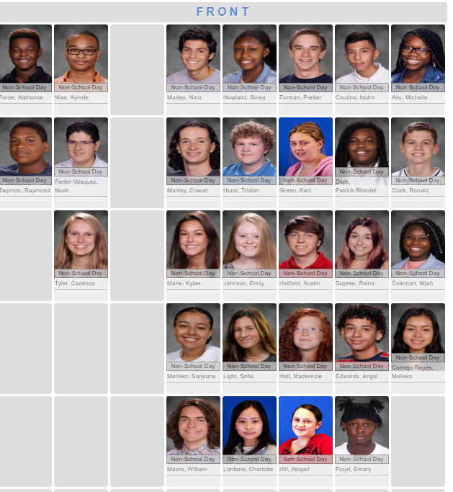
Welcome 2nd Block
Day One
Find your seat

Slide 2
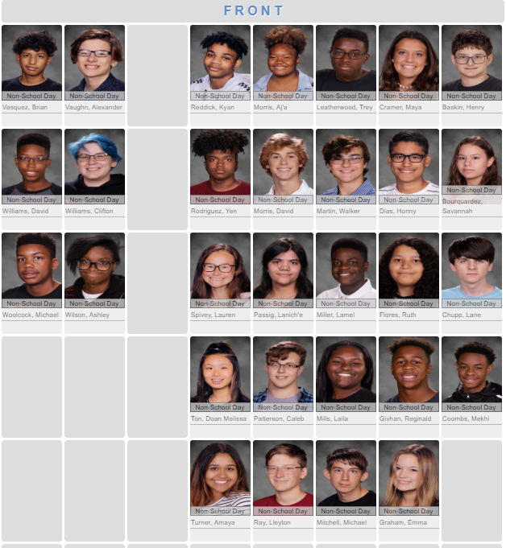
Welcome 3rd Block
Day One
Find your seat

Slide 3
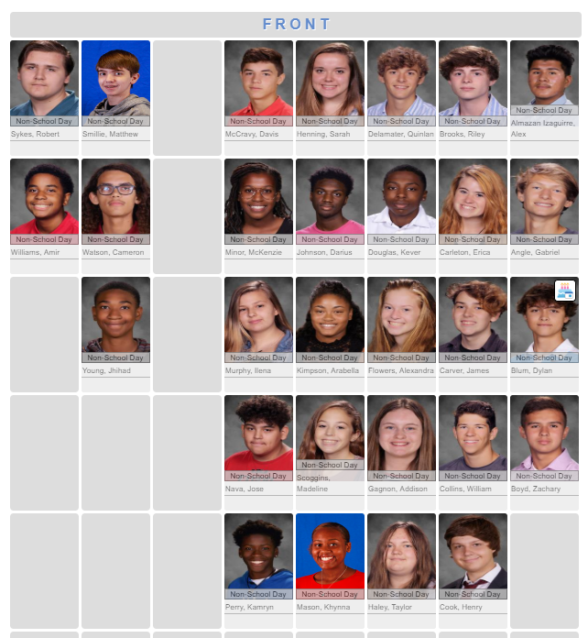
Welcome 4th Block
Day One
Find your seat

Slide 4
Agenda
Syllabus/ School Expectations
Class Norms
Perspective

Slide 5
One Word 2020 *Link 1 (2min) *Link 2 (USA Today)
Adapted from oneword365.com

Slide 6
One Word 2020
Just one word.
One word you can focus on every day, all year long… One word that sums up WHO you want to be or HOW you want to live.
Discover the big impact one word can make.
One word. 365 days. A changed life.

Slide 7
Focus on being rather than doing.
It stands to inspire how you want to live.
Select ONE word that will help you become that.
Be Authentic. You want a word that’s uniquely yours.

Slide 8
Time to think…
Spend some time imagining what you want your life to look like. What kind of person do you really want to be at the end of 2020? What do you want the condition of your heart and your relationships to be? What is in your heart? What character traits do you have? What are your best qualities? Who do you want to be in 2020?
Make a list of words (8-20) that sum up that description or that create an image of that vision you started with. It can include nouns (such as peace or joy), adjectives (like thoughtful or brave), verbs (like create or pause) or even prepositions (like with or up).

Slide 9
Last Step
3. Narrow your list down to the few words that resonate most with you (meaning they mean the most to you).
Take some time to look them up in the dictionary / thesaurus, and try out similar words. Really dive into the true meaning of each word.
4. Take a deep breath and commit.
Think about what it would be like to intentionally focus on this word.
Write your word in large print on paper provided. Write an explanation of your word in ink on the back: What is its definition? Why did you choose it? How will you focus on this word moving forward? How can this word move you forward positively?

Slide 10
My Example:

Slide 11
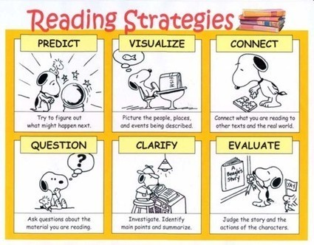
Welcome Day 2
Be sure to get a copy of the Warm-Up handout “Rebecca” ** on the front table and start reading the passage/ answering the questions.

Slide 12
Wrap-up Class Expectations & One Word
Anything else?
What expectations do you have for yourself and your peers?

Slide 13
Agenda
Warm-up: Cold Reading #1
01
Semester Lit Terms: Characterization
02
Set-up Writer’s Notebook
04
Unit 1: Ethnic Hash
03

Slide 14
Notes: “Semester Long Terms” (Put this handout in the “notes” section of your binder)
1. Characterization:
A. Direct
B. Indirect
C. Static
D. Round
E. Flat
F. Dynamic

Slide 15
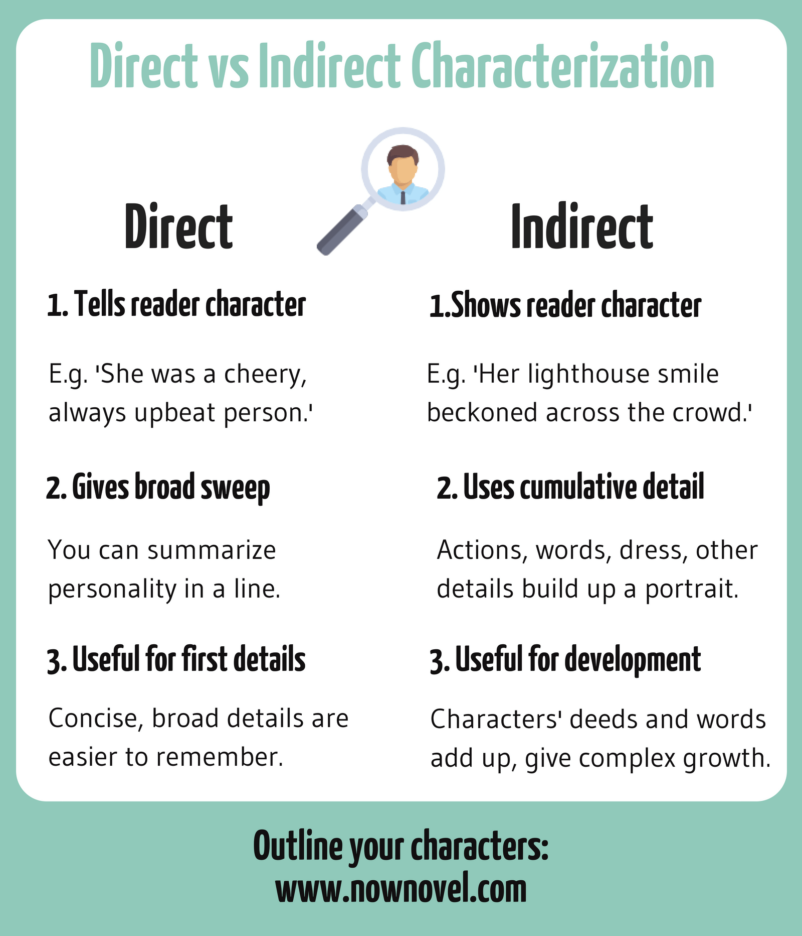
Jot down the bold print:
Why does an author use direct or indirect characterization?

Slide 16
Characterization Examples:

Slide 17
Ethnic Hash
Handout:
Fresh Prince**
Mindy Project- season 4, episode 18 (4 segments)
Story “Ethnic Hash” by Patricia J. Williams
What does the metaphorical title suggest about the author’s cultural identity?
Annotate for evidence.

Slide 18
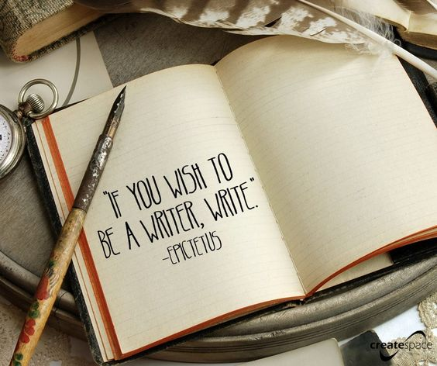
Setting up your Writer’s Notebook
Table of contents page
Number pages 1-50 (odd #s)
Title Page 1:
“Reflection”
Name on Front

Slide 19
HW: Read Article
Quiz Wednesday over content.

Slide 20
Welcome Day3!
Did you read your homework assignment?
Quiz in 5 minutes

Slide 21
Agenda
Reading Quiz/ Writer’s Notebook #1
Springboard: Ethnic Hash
Writing Claims
FlipGrid Assignment

Slide 22
Writer’s Notebook –page 3
Prompt:
“In the article Gate A-4, the speaker uses her ability to speak both English and Arabic to help a stranger.
How can shared experiences help people see beyond their differences and come together?
–OR –
Why might people be reluctant to help others?
At the end of your writing you should also reflect on Atlas’ speech by connecting his ideas to your own.
On the Table of Contents, write the page, title, and today’s date:
On the top of page 3, place the title & today’s date:
As you write, do so in complete sentences.
Goal: Write everything you can think of and use up at least ¾ of a page.

Slide 23
Swap
Write a note:
1. Choice:
A. A question
B. “I agree…”
C. “What if…”
D. WOW! moment
II. Where is one place they can add more detail. Identify it on your post-it note

Slide 24
Ethnic Hash
Handout:
Fresh Prince**
Mindy Project- season 4, episode 18 (4 segments)
Story “Ethnic Hash” by Patricia J. Williams
What does the metaphorical title suggest about the author’s cultural identity?
Annotate for evidence.

Slide 25
Abigail | Cowan | Austin | Angel | Charlotte | Cadence
A.J. | Kaci | Ayinde | Nijah | Isidro | Emily
Mackenzie | Kylee | Emory | Raymond | Noah | Patrick
Nino | Michelle | Melissa | Sarjeane | Parker | Tristan
Ronald | Sofia | Sinea | Will | Reina
Welcome Day 4
Be sure to pick up the WARM-UP handout, “Close Reading #2”, from the front of the room.

Slide 26
Henry | Ruth | Michael M. | Yen | Kyan | Lamel
Emma | Savannah | Amaya | Lane | Lleyton | Honny
Laila | Lauren | Trey | Michael W. | Mekhi | David M.
Aj’a | David W. | Doan | Walker | Brian | Alex
Clif | Tyler |  | Maya | Lanich’e | Caleb
Welcome Day 4
Be sure to pick up the WARM-UP handout, “Close Reading #2”, from the front of the room.

Slide 27
Group 1 | Group 2 | Group 3 | Group 4 | Group 5 | Group 6 | Group 7
Addison | Khynna | Quin | Alex | Gabe | Erica | Maddie
Kever | Sarah | Allie | Ashton | Henry | Bella | Bobby
Taylor | McKenzie | Jose | Matthew | Will | Zach | Cameron
Davis | Ilena | Riley | Amir | Darius | Dylan | Jhihad
Welcome Day 4
Be sure to pick up the WARM-UP handout, “Count of Monte Cristo”, from the front of the room.

Slide 28
Agenda
Warm-up: Cold Reading #2
Speed Dating
Springboard: Two Kinds Continued
FlipGrid Assignment
Claims & Evidence (HW)

Slide 29
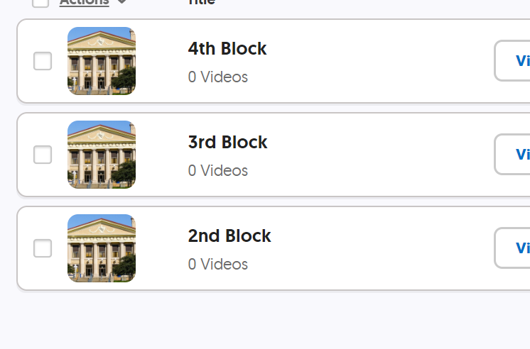
Flipgrid code: flipgrid.com/ellwood4107

Slide 30
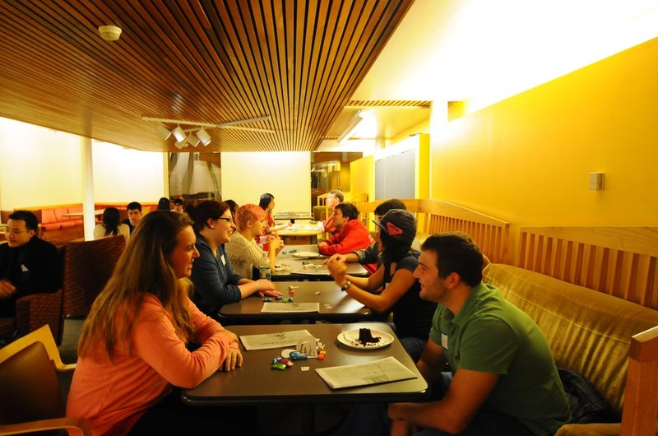
Goal: Finding the one…
A timer will be set. Stay in your place until the timer goes off.
QUICKLY move to a new location for the second, third, and fourth round
Fill out the speed dating form to help you find THE ONE.
Move to the next book and repeat the process.
You will hand in your forms at the end of the dating period.

Slide 31
Springboard: “Two Kinds”
Chunk 1: (Handout)
Annotations:
~ Characterization examples.
~ Reading purpose question:
~Claim statement:
Chunk 2: (Handout)
Tonight: READ and ANNOTATE to find EVIDENCE to help us answer the 5 questions.
We will start by reviewing Chunk 1 questions/ answers that you FINISH TONIGHT.
We will work in SAME groups tomorrow to answer CHUNK 2 questions.

Slide 32
Welcome to Day 5
IT’s FRIDAY!!
Grab your Independent Novel from the list posted on the board and ONE post-it note.

Slide 33
Agenda
IR Norms/ Reading/ Discussion
Warm-up: Film Clip Friday #1
Springboard: Two Kinds
Intro: “9 Alignments”
Extra time? Claim & Quiz Feedback

Slide 34
Independent Reading
Expectations:
Have a book.
Read actively.
Stay Awake.
Keep your cellphone put away.

Slide 35
IR Expectations
Need an IR book everyday. 10-15 minutes EVERYDAY.
Will have an IR project based on the book you are reading in class.

Slide 36
Reminder: 1st “Big” assignment Due
Flipgrid Assignment Part 1: Due Monday, January 13th by 11:59PM;
Part 2: Due Wednesday, January 15th by 11:59PM

Slide 37
Film Clip Friday #1: In Warm-up Section of Notebook…include today’s date
The Corpse Bride (Tim Burton/music by Danny Elfman) - http://www.youtube.com/watch?v=nuEOA9GbK6U
Describe the music you hear and note what occurs in the scene with the music.
What is the effect of the music? How does it function in the scene?

Slide 38
Springboard: “Two Kinds”
Chunk 3:
Annotations:
~ Characterization examples.
~ Reading purpose question:
Chunk 4:
Annotations:
~ Characterization examples.
~ Reading purpose question:

Slide 39
Springboard: “Two Kinds”
Chunk 5:
Annotations:
~ Characterization examples.
~ Reading purpose question:
Chunk 6:
Annotations:
~ Characterization examples.
~ Reading purpose question:

Slide 40
9 Alignments
Analyzing Characters in a story
(Using/ applying characterization)

Slide 41
Article: What is an alignment?
9 alignment descriptors
Popular TV and Movie alignments

Slide 42
Lawful Good Follows a code, either internal or external (told what to do) Helps people (good soldier, or Superman type) | Neutral Good Sometimes follows a code, sometimes willing to break or bend rules for own benefit Helps People | Chaotic Good A Rebel Follows no rules or code Does what they want Helps people
Lawful Neutral Follows a code, either internal or external Focused solely on rules or code Does nothing to help or hurt. | True Neutral Has no discernible alignment either way. Does nothing good or evil, shows no law or chaos Wild animals fall into this category | Chaotic Neutral Does what they wish for their own personal gain Does nothing to help or hurt.
Lawful Evil Follows a code, either internal or external (told what to do) Hurts people (evil soldier) | Neutral Evil Has a reason for what he or she does Hurts people (NORMALLY the main villain) | Chaotic Evil Does whatever they want Hurts people Has no real reason for what they do

Slide 43
Lawful Good | Neutral Good | Chaotic Good
Lawful Neutral | True Neutral | Chaotic Neutral
Lawful Evil | Neutral Evil | Chaotic Evil

