Slide 1
Vocab 6B Practice

Slide 2
#1 Which word matches the picture?
Fetter
Megalomania
Insurgent

Slide 3
#2 Which word matches the picture?
Sinecure
Transgress
Heinous

Slide 4
#3 Which word matches the picture?
Immutable
Fetter
Surreptitious

Slide 5
#4 Which word matches the picture?
Transgress
Megalomania
Heinous

Slide 6
#5 Which word matches the picture?
Vicarious
Heinous
Transmute

Slide 7
#6 Which word matches the picture?
Transmute
Sinecure
Immutable

Slide 8
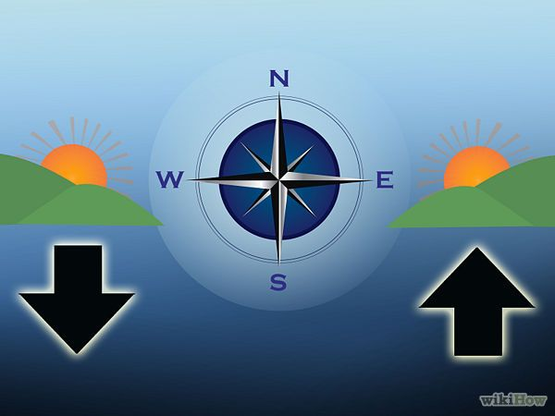
#7 Which word matches the picture?
Vicarious
Immutable
Megalomania

Slide 9
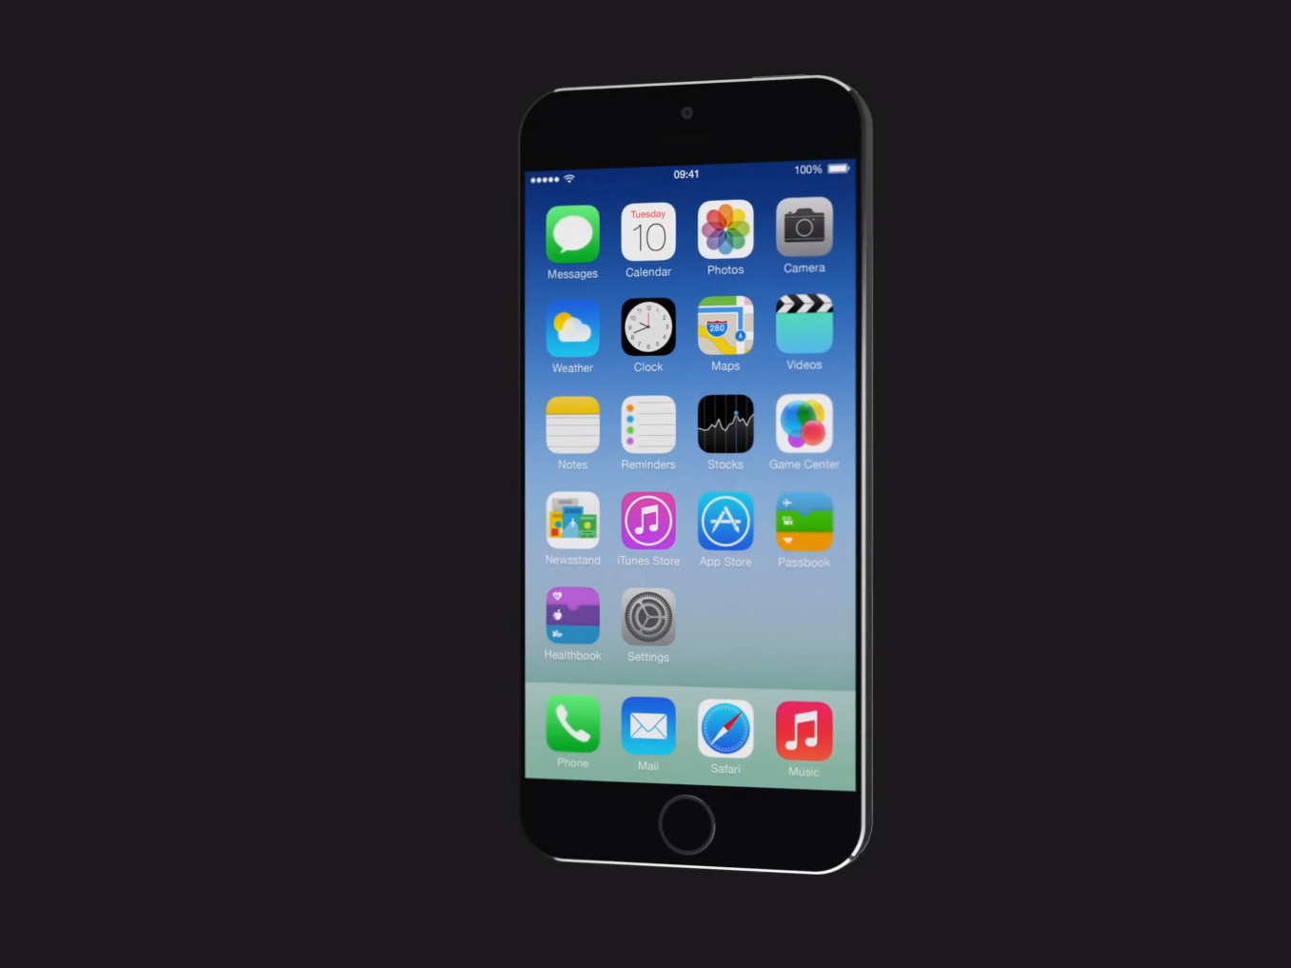
#8 Which word matches the picture?
Fetter
Vicarious
Sinecure

Slide 10
#9 Which word matches the picture?
Insurgent
Megalomania
Surreptitious

Slide 11
#10 Which word matches the picture?
Transmute
Insurgent
Vicarious

Slide 12
Answer Slides

Slide 13
#1 Which word matches the picture?
Fetter
Megalomania
Insurgent

Slide 14
#2 Which word matches the picture?
Sinecure
Transgress
Heinous

Slide 15
#3 Which word matches the picture?
Immutable
Fetter
Surreptitious

Slide 16
#4 Which word matches the picture?
Transgress
Megalomania
Heinous

Slide 17
#5 Which word matches the picture?
Vicarious
Heinous
Transmute

Slide 18
#6 Which word matches the picture?
Transmute
Sinecure
Immutable

Slide 19
#7 Which word matches the picture?
Vicarious
Immutable
Megalomania

Slide 20
#8 Which word matches the picture?
Fetter
Vicarious
Sinecure

Slide 21
#9 Which word matches the picture?
Insurgent
Megalomania
Surreptitious

Slide 22
#10 Which word matches the picture?
Transmute
Insurgent
Vicarious

