Slide 1
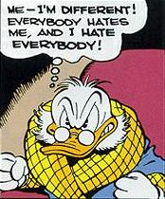
Acrimonious
ADJ.- stinging, bitter in temper or tone
Synonyms: Biting, rancorous, hostile, peevish
Antonyms: gentle, warm, mild, cordial

Slide 2
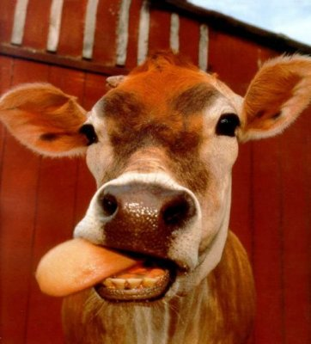
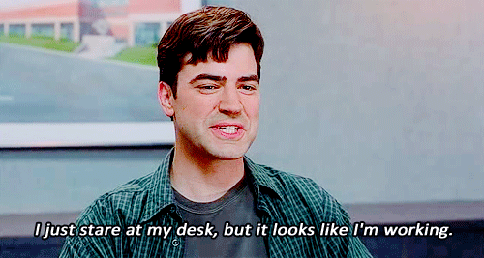
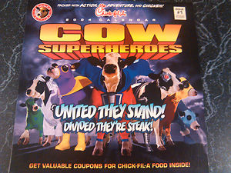
Bovine
ADJ.- resembling a cow or ox; sluggish, unresponsive
Syn: Stolid, dull, slow, stupid
Ant: sharp, bright, keen, quick

Slide 3
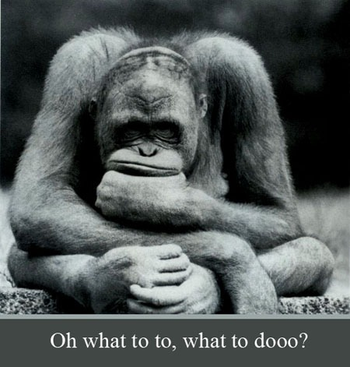
Consternation
N. Dismay, Confusion
Synonym: shock, amazement, bewilderment, dismay
Antonyms: calm, composure, aplomb

Slide 4
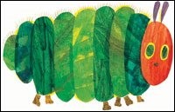
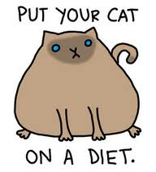
Corpulent
ADJ.- fat, having a large, bulky body
Syn: overweight, heavy, obese, stout, portly
Ant: slender, lean, spare, gaunt, emaciated

Slide 5
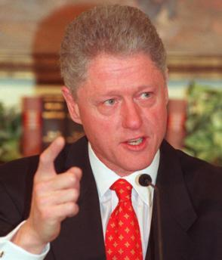
Disavow
V.- to deny responsibility for or connection with
Syn: disclaim, retract, abjure
Ant: acknowledge, admit, grant, certify

Slide 6
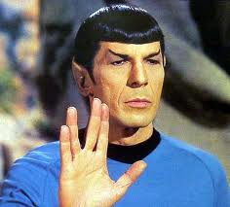
Dispassionate
ADJ. – impartial, calm, free from emotion
Syn: Unbiased, disinterested, cool, detached
Ant: committed, engaged, partial, biased

Slide 7
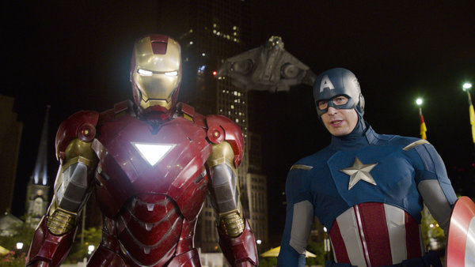
Dissension
N.- disagreement, sharp difference of opinion
Syn: Strife, Discord, contention
Ant: agreement, accord, harmony

Slide 8
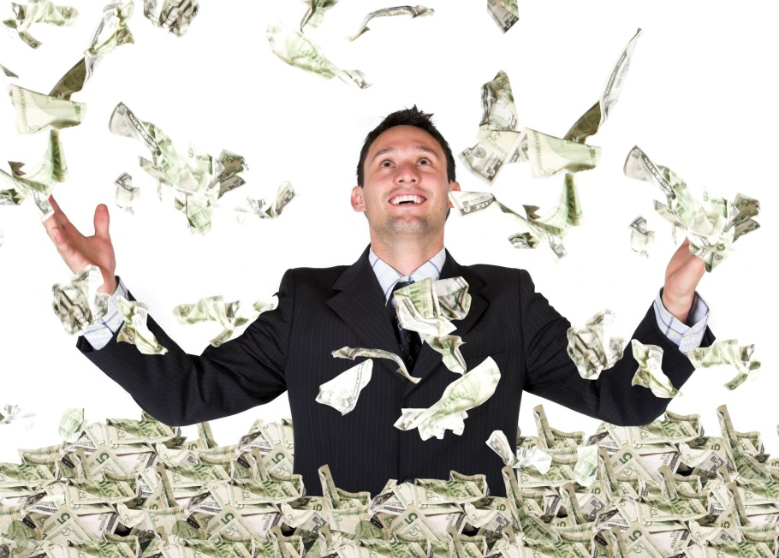
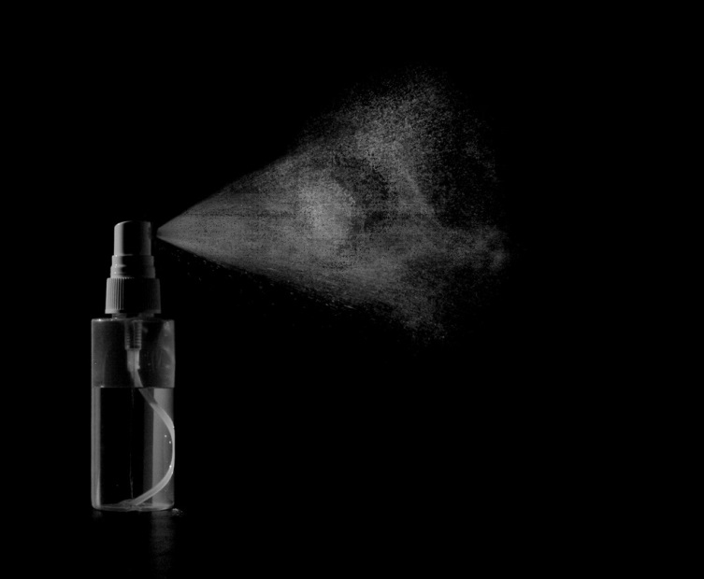
Dissipate
V.- to cause to disappear; to scatter; to dispel; to spend foolishly, squander; to be extravagant in pursuit of pleasure
Syn: disperse, strew, diffuse, waste,
Ant: gather, collect, conserve, husband

Slide 9
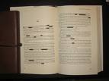
Expurgate
V. – to remove objectionable passages or words from a written text; to cleanse , purify
Syn: Censor, Purge, Bowlderdize

Slide 10
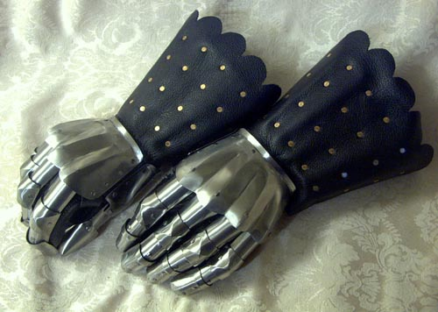
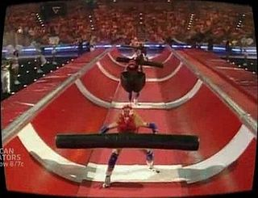
Gauntlet
N. – an armored or protective glove; a challenge; two lines of men armed with weapons with which to beat a person forced to run between them; an ordeal
Syn: Dare, provocation, trial, punishment.

Slide 11
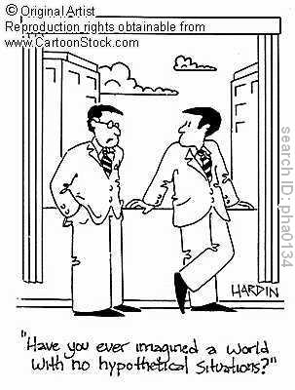
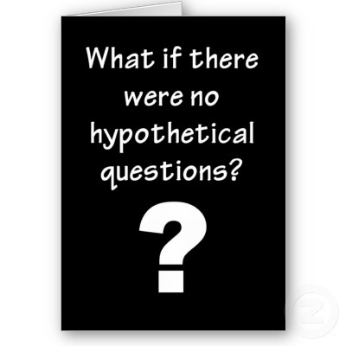
Hypothetical
ADJ.- based on an assumption or guess; used as a provisional or tentative idea to guide or direct investigation
Syn: assumed, supposed, conditional
Ant: actual, real, tested

Slide 12
Ignoble
ADJ.- mean, low, base
Synonyms: Inferior, unworthy, sordid
Ant: Admirable, praiseworthy, lofty

Slide 13
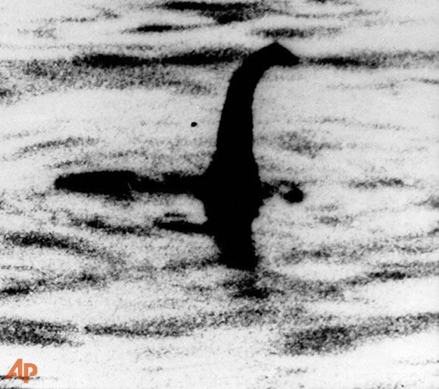
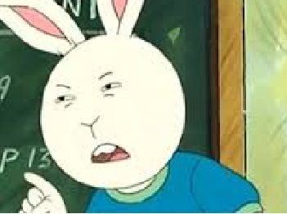
Impugn
V.- to call into question; to attack as false
Synonym: challenge, deny, dispute, query
Ant: confirm, prove, verify, validate

Slide 14
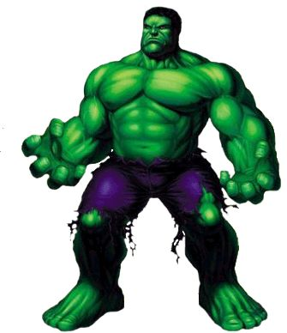
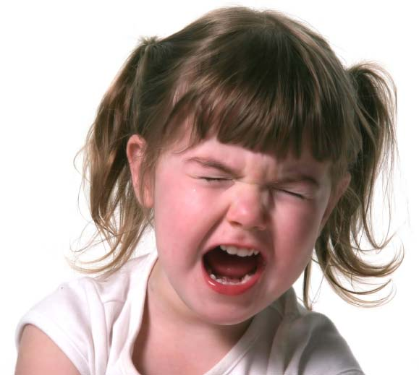
Intemperate
ADJ.- immoderate, lacking in self-control; inclement
Syn: excessive, extreme, unrestrained, inordinate
Ant: Moderate, restrained, cool, collected

Slide 15
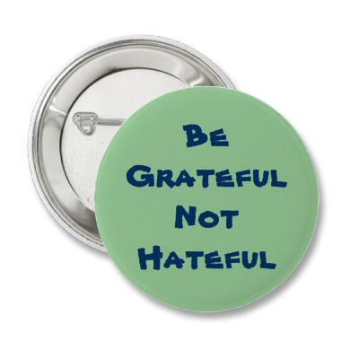
Odium
N.- hatred, contempt, disgrace or infamy resulting from hateful conduct
Syn: Abhorrence, Opprobrium, shame, ingnominy
Ant: esteem, admiration, apporbation

Slide 16
Perfidy
N.- faithlessness, treachery
Syn: Betrayal, disloyalty, treason
Ant: Faithfulness, loyalty, steadfastness

Slide 17
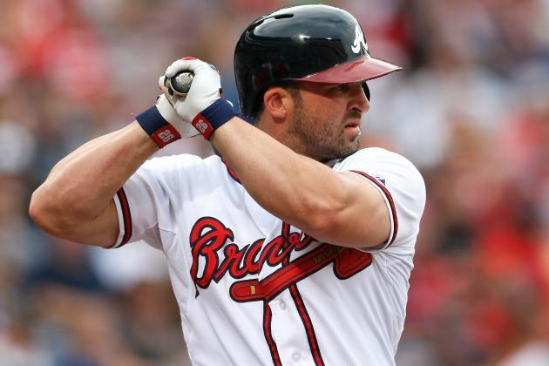
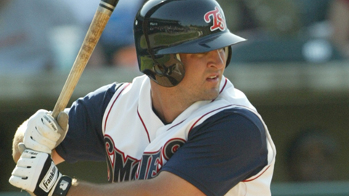
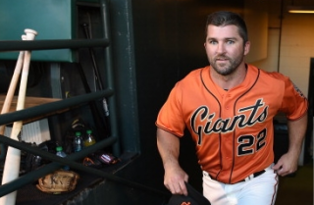
Relegate
V.- to place in a lower position; to assign, refer, turn over, banish
Syn: transder, consign, demote, exile
Ant: promote, elevate, advance, recall

Slide 18
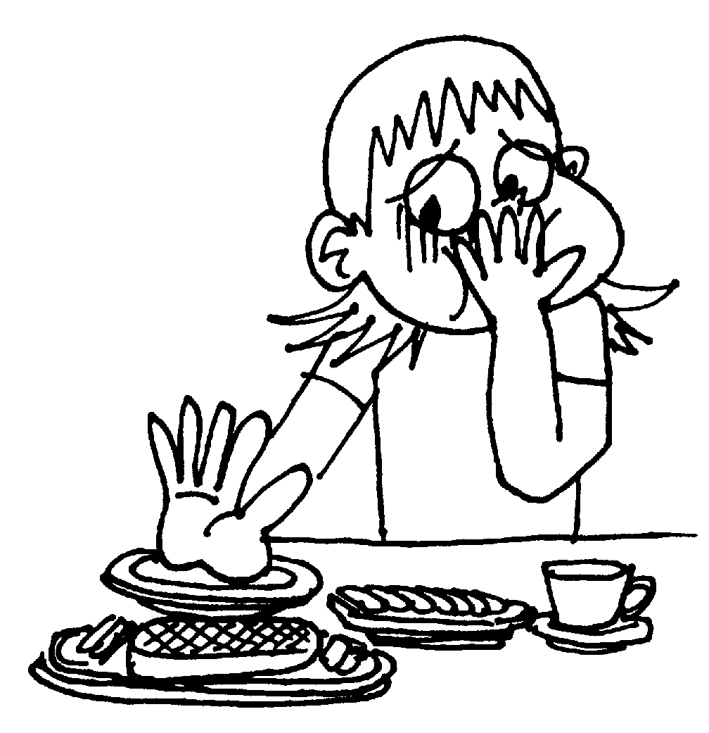
Squeamish
ADJ.- inclined to nausea; easily shocked or upset; excessively fastidious or refined
Syn: nauseated, queasy, delicate, oversensitive, priggish

Slide 19
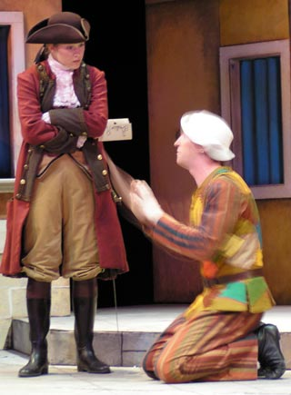
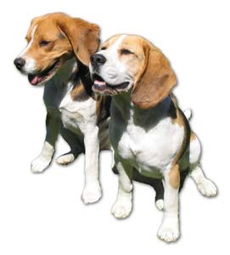
Subservient
ADJ.- subordinate in capacity or role; submissively obedient; serving to promote some end
Syn: Secondary, servile, Obsequious, useful
Ant: Primary, Principal, bossy, domineering

Slide 20
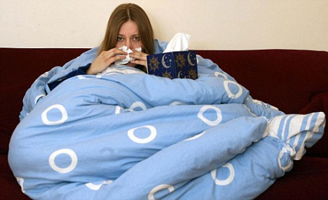
Susceptible
ADJ.- Open to; easily influenced; lacking resistance
Syn: Vulnerable, receptive, impressionable
Ant: Resistant, immune

