Slide 1
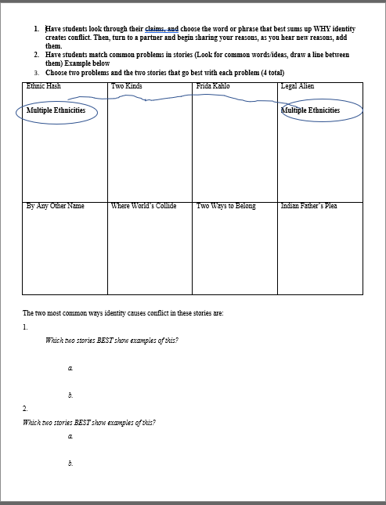
SPRINGBOARD VOCABULARY UNIT 2 Get your Springboard, your IR, and that chart from last week where I made you draw all the lines and stuff. This one →→→ →

Slide 2
Attribute (noun)
Quality or feature regarded as a characteristic or inherent part of someone or something.

Slide 3
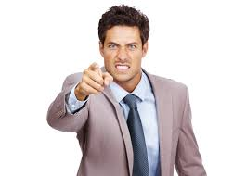
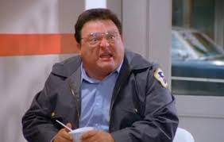
Disgruntled (adj)
Angry or dissatisfied

Slide 4
facilitate (verb)
to make easier; to assist
Synonyms: ease, expedite, streamline

Slide 5
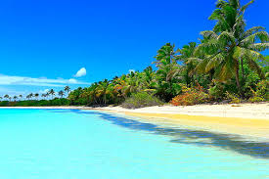
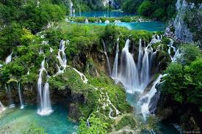
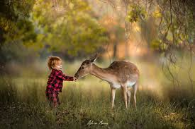
Idyllic (adj)
Naturally peaceful

Slide 6
inclination (n)
a preference; a tendency to act in a certain way

Slide 7
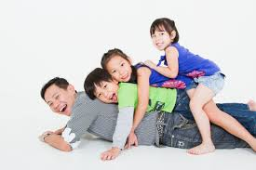
Insulate (v)
To protect from outside influence

Slide 8
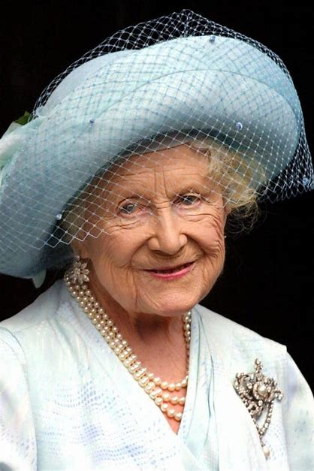
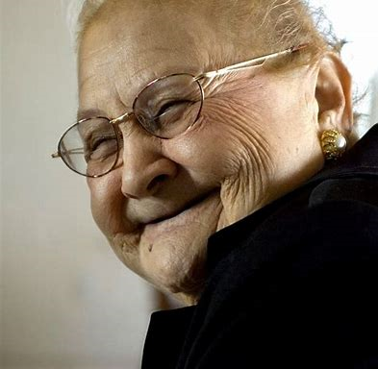
matriarch (n)
A woman who is the head of the family or tribe

Slide 9
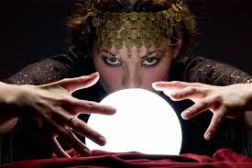
oracle (n)
someone or something that can predict the future

Slide 10
partisan (n/adj)
One-sided, prejudiced; committed to a party

Slide 11
Prestigious (adj.)
having a highly favorable reputation, commanding respect
Syn: reputable, distinguished, eminent

Slide 12
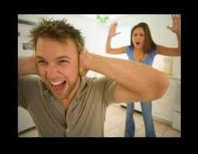
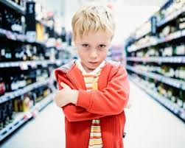
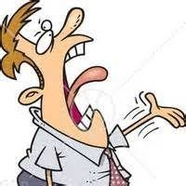
querulous (adj)
Habitually complaining

Slide 13
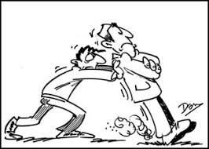
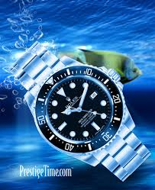
resistant (adj)
Having the ability to fight against

Slide 14
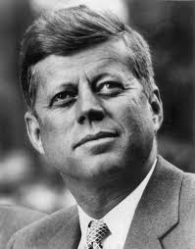
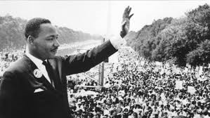
revered (verb)
respected or honored
Syn: admired, honored, esteeemed

Slide 15
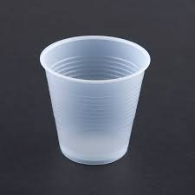
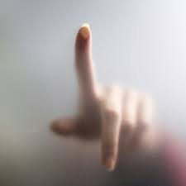
Translucent (adj)
Allowing light to pass through

Slide 16
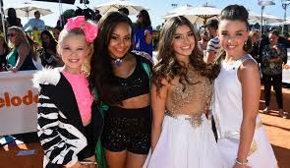
Vicarious (adj)
Experiencing through another

Slide 17
https://quizlet.com/_542mzt

