Slide 1
The
Hillgrove Teacher Culture
By: The Hillgrove 10th Lit Team

Slide 2
Teachers have lives outside of school just like you.
Saw My Teacher On A Saturday
Saw my teacher on a Saturday!
I can’t believe it’s true!
I saw her buying groceries,
like normal people do!
She reached for bread and turned around,
and then she caught my eye.
She gave a smile and said, “Hello.”
I thought that I would die!
“Oh, hi…hello, Miss Appleton,”
I mumbled like a fool.
I guess I thought that teacher types
spend all their time at school.
To make the situation worse,
my mom was at my side.
So many rows of jars and cans.
So little room to hide.
Oh please, I thought, don’t tell my mom
what I did yesterday!
I closed my eyes and held my breath
and hoped she’d go away.
Some people think it’s fine to let
our teachers walk about.
But when it comes to Saturdays,
they shouldn’t let them out!
By: Dave Crawley
Notes:
While teachers want to be available to help students before or after school, sometimes there are personal commitments that make that difficult. Teachers often receive e-mails or other communication outside of school hours but are not always looking at their computer or available to respond right away. Helping students succeed is very important to teachers but making time for family and friends is important as well.

Slide 3
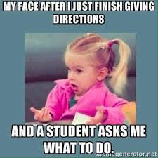
Teachers must endure repetitive comments and questions.
Notes:
When giving instructions, teachers hope that students are all listening and paying attention; however, many are not paying attention due to their own choices or sometimes issues beyond their control. When students ask questions that have already been answered, teachers feel frustration having to repeat what has already been said.

Slide 4
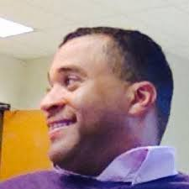
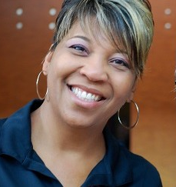
The most prominent figure for Hillgrove teachers is Ms. Angela Stewart, because she is the principal, and therefore in charge of when we get to wear jeans.
Notes:
Teachers may be “the boss” inside of the classroom and in the hallways but teachers have bosses too! Ms. Stewart is in charge of ensuring Hillgrove runs smoothly and she has to make many decisions about how to best accomplish that. Luckily for the teachers (and students), Ms. Stewart has decided not to change the dress code we had last year so teachers can still wear jeans on Thursdays AND Fridays!

Slide 5
Reflections (you will provide an answer)
1) Which aspects of your cultural identity were you already aware of before you began this unit, and which did you discover through your study?
2) What are some of the different cultural heritages represented in your class that you became aware of through class discussions or shared writing?

