Slide 2
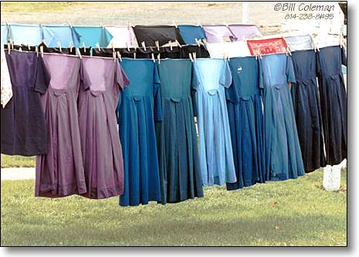
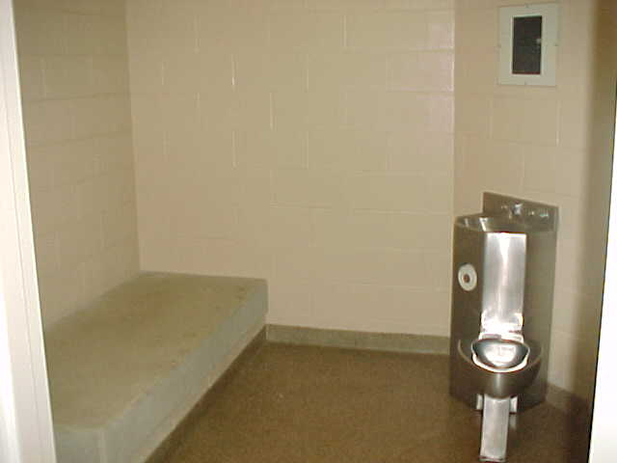
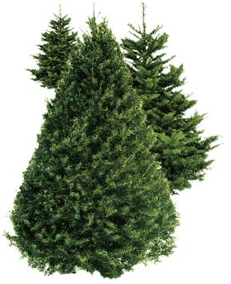
Austere
(adj.)
severe or stern in manner
without adornment or luxury, simple, plain
harsh or sour in flavor
Synonyms: unemotional

Slide 3
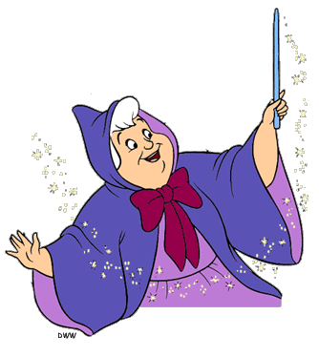
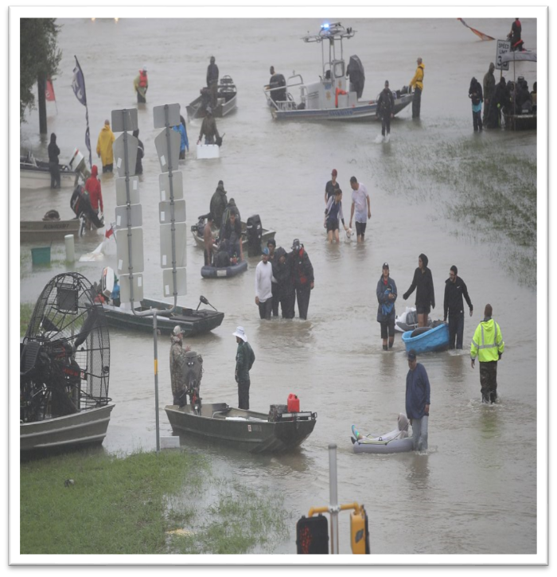
Beneficent
(adj.)
Performing acts of kindness or charity
Conferring benefits, doing good
Syn: humanitarian, magnamimous, charitable

Slide 4
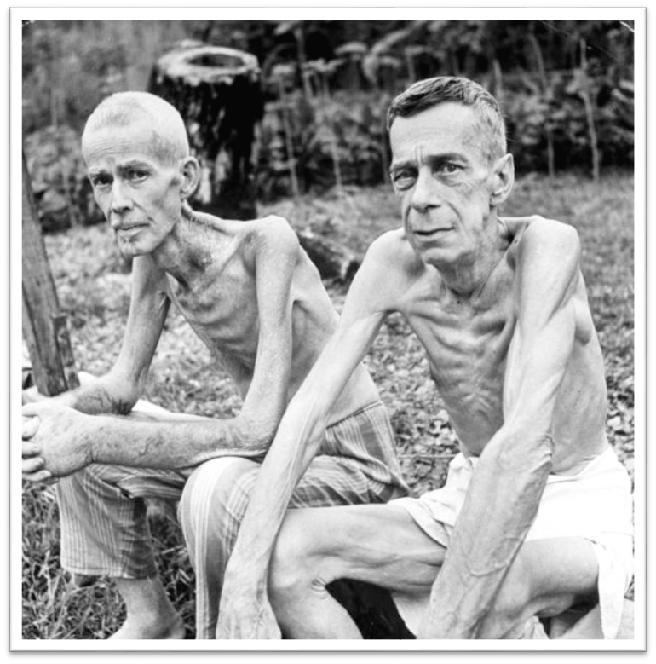
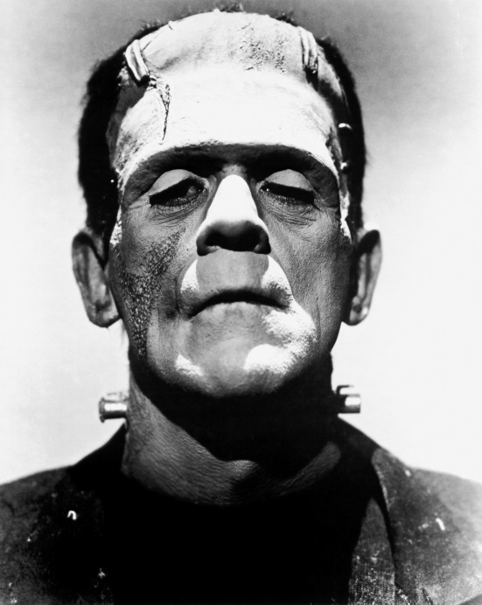
Cadaverous
(adj.)
pale, gaunt, resembling a corpse
Syn: Corpselike, Wasted, haggard, emaciated, ghastly

Slide 5
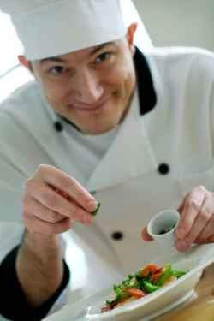
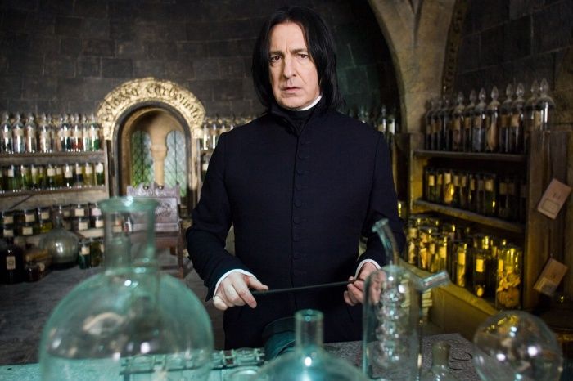
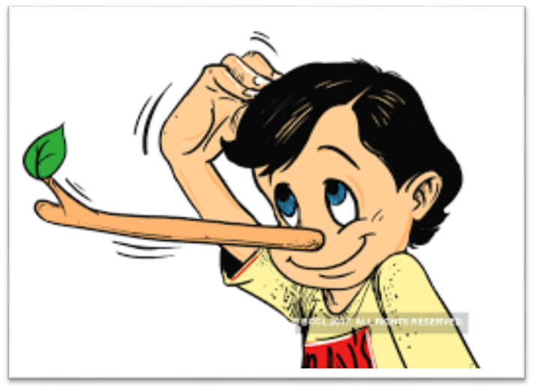
Concoct
(v.)
To prepare by combining ingredients, make up (as a dish)
To devise, invent, fabricate
Syn: create, fashion, rustle up

Slide 6
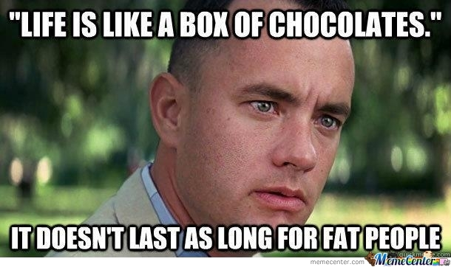
Crass
(adj.)
coarse, unfeeling
stupid\
Syn: crude, tastless, oafish, obtuse, asinine

Slide 7
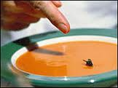
Debase
(v.)
to lower in character, quality, or value
to degrade, adulterate
to cause to deteriorate
Synonyms: Cheapen, corrupt, demean, depreciate,

Slide 8
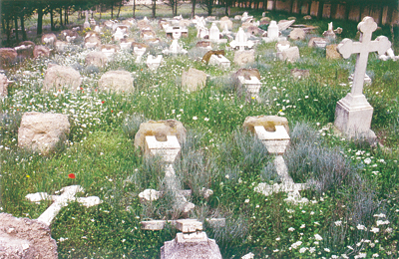
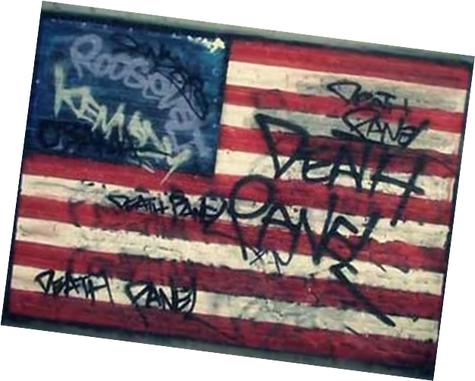
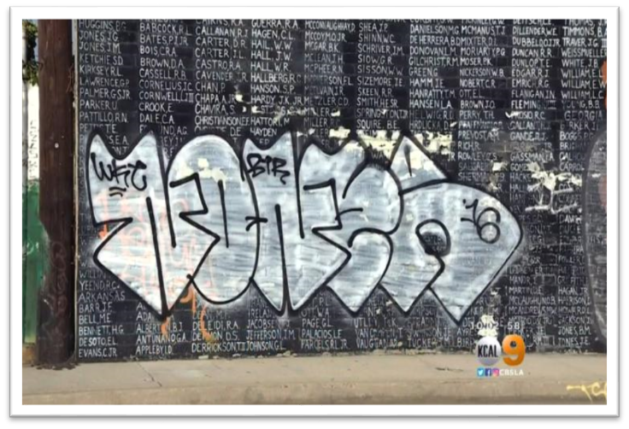
Desecrate
(v.)
to commit sacrilege upon, treat irreverently
to contaminate, pollute
Syn: Profane, defile, violate
Vandals Deface Vietnam War Memorial In Venice, CBS, Los Angeles, May 27, 2016

Slide 9
Disconcert
(v.)
to confuse
to disturb the composure of
Syn: Upset, rattle, ruffle, faze

Slide 10
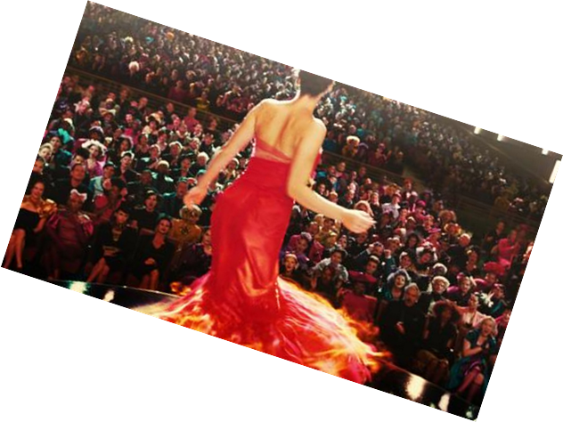
Grandiose
(adj.)
grand in an impressive or stately way
marked by pompous affectation or grandeur, absurdly exaggerated
Synonym: Magnificent, Majestic, bombastic, highfalutin

Slide 11
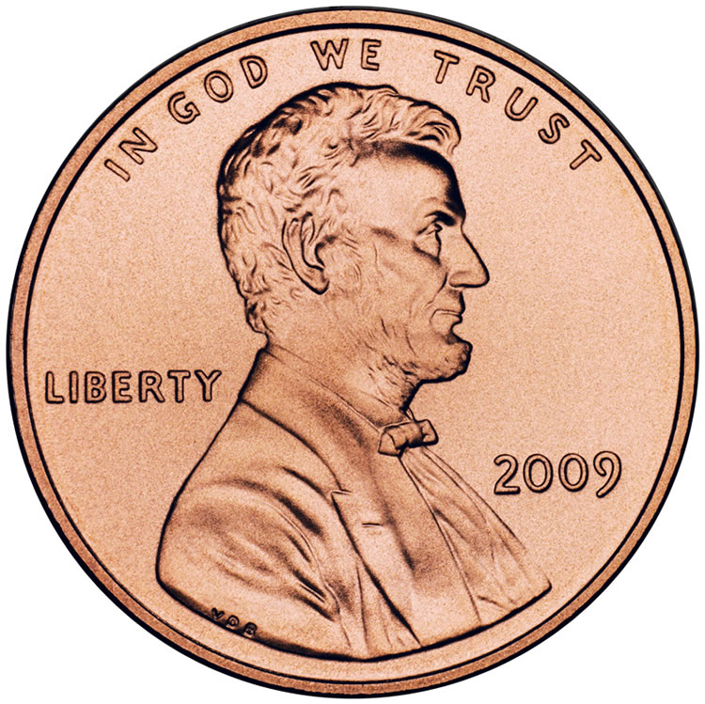
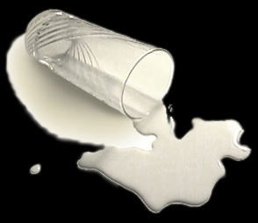
Inconsequential
(adj.)
Trifling, unimportant
Synonym: trivial, negligible, paltry

