Slide 1
9 Alignments
Analyzing Characters in a story

Slide 2
Lawful Good Follows a code, either internal or external (told what to do) Helps people (good soldier, or Superman type) | Neutral Good Sometimes follows a code, sometimes willing to break or bend rules for own benefit Helps People | Chaotic Good A Rebel Follows no rules or code Does what they want Helps people
Lawful Neutral Follows a code, either internal or external Focused solely on rules or code Does nothing to help or hurt. | True Neutral Has no discernible alignment either way. Does nothing good or evil, shows no law or chaos Wild animals fall into this category | Chaotic Neutral Does what they wish for their own personal gain Does nothing to help or hurt.
Lawful Evil Follows a code, either internal or external (told what to do) Hurts people (evil soldier) | Neutral Evil Has a reason for what he or she does Hurts people (NORMALLY the main villain) | Chaotic Evil Does whatever they want Hurts people Has no real reason for what they do

Slide 3
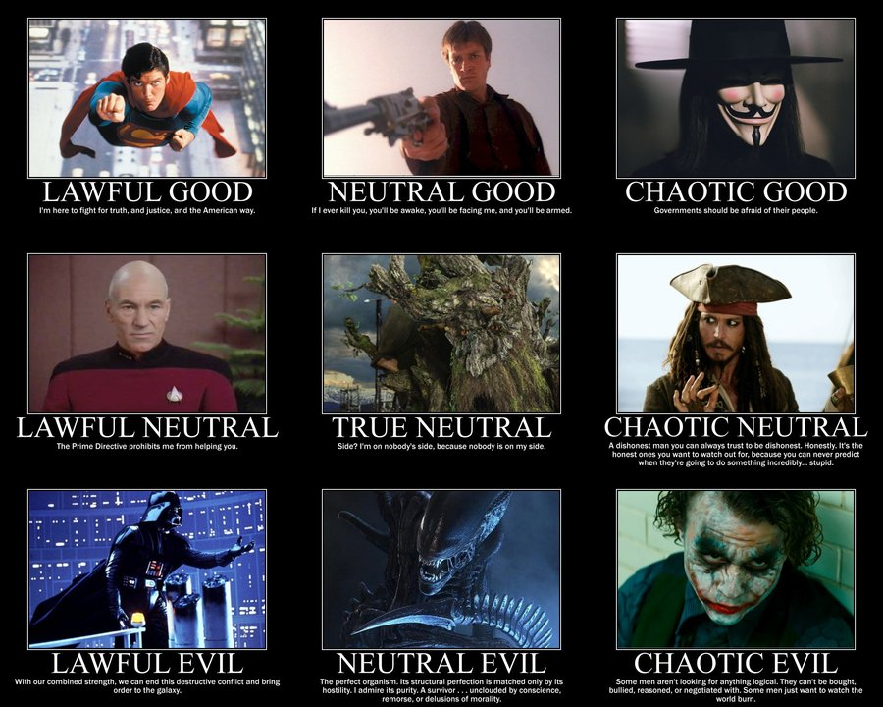

Slide 4
